Slide 1
GROUP -7 ANT COLONY OPTIMIZATION ALGORITHMS AND DEMONSTRATION Harsha Vardhan Alladi – NFB15 Madhan Mohan Madala – CCK60 Sreeja Kukkala – SWT36

Slide 2
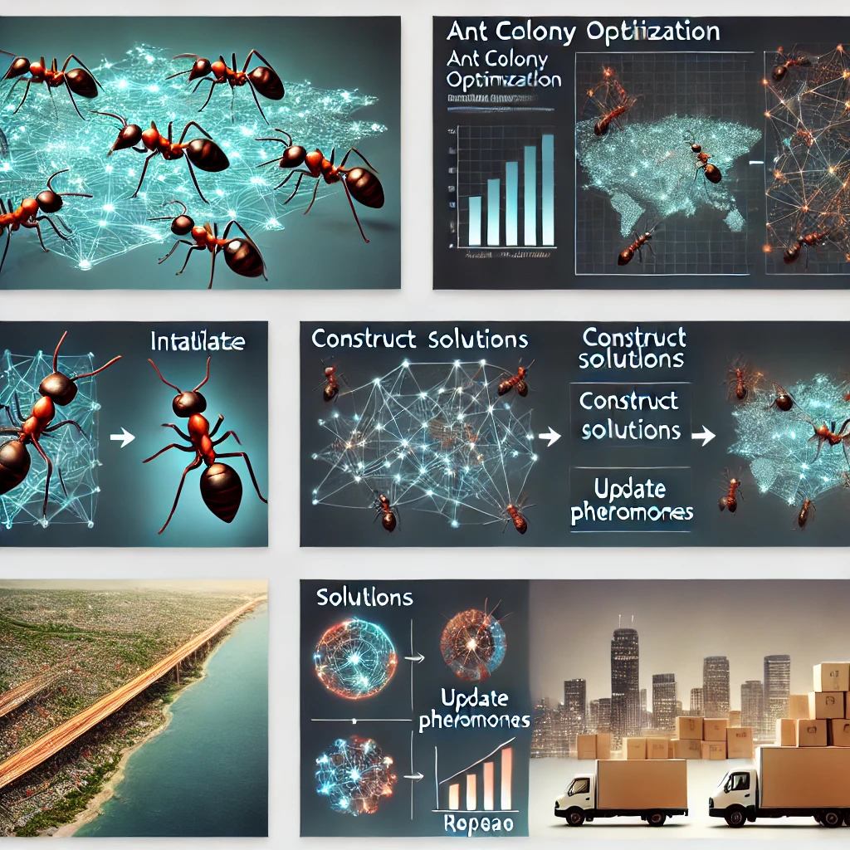
Introduction to Ant Colony Optimization (ACO)
Overview
Ant Colony Optimization (ACO) is a nature-inspired optimization algorithm that mimics the behavior of ants in finding the shortest path between their nest and food sources. It is a heuristic method, meaning it provides good solutions within reasonable computational times for complex problems where exact solutions are infeasible to compute. ACO is particularly effective for solving combinatorial optimization problems such as the Traveling Salesman Problem (TSP), Vehicle Routing Problem (VRP), and job scheduling tasks.

Slide 3
Main Idea
ACO is based on the observation of real ant colonies. When ants search for food, they deposit a chemical substance called pheromone along the paths they traverse. Other ants detect these pheromones and are more likely to follow paths with higher pheromone intensity. Over time, as more ants traverse shorter paths, those paths accumulate more pheromones, reinforcing their desirability. This positive feedback mechanism helps the colony collectively discover the most efficient routes to food sources.
In ACO, this natural behavior is translated into a computational model:
Pheromone Trails: Represent the desirability of a path.
Heuristic Information: Represents problem-specific factors like distance or cost.
Exploration and Exploitation: Balancing the discovery of new paths with the reinforcement of known good paths.

Slide 4
Historical Background
ACO was first proposed by Marco Dorigo in his 1992 Ph.D. thesis. The initial algorithm, called the Ant System (AS), was designed to solve the TSP. Since then, ACO has evolved into a family of algorithms with significant improvements, such as:
Ant Colony System (ACS): Introduced a better pheromone update mechanism.
MAX-MIN Ant System: Limited pheromone intensities to prevent premature convergence.
Elitist Ant System: Reinforced the best-known solutions more strongly.
Over the years, ACO has been successfully applied to a wide range of problems beyond routing, including network design, resource allocation, and bioinformatics. Its adaptability and robustness make it a cornerstone of bio-inspired computing.

Slide 5

Algorithm Description: Ant Colony Optimization (ACO)
The Ant Colony Optimization algorithm simulates the collective behavior of ants to solve optimization problems. Below is a detailed step-by-step explanation of the algorithm, including the intuition behind each step, stopping conditions, and user-controlled parameters.
Main Steps of the Algorithm:
1) Initialization
2) Ant Solution Construction
3) Pheromone Update
4) Iteration

Slide 6
Initialization
Define the problem as a graph, where nodes represent components (e.g., cities in the TSP) and edges represent possible transitions (e.g., distances between cities).
Initialize pheromone levels equally for all edges.
Set algorithm parameters such as:
Alpha (α): Weight of pheromone importance.
Beta (β): Weight of heuristic importance (e.g., 1/distance).
Evaporation Rate (ρ): Rate at which pheromone decays.
Number of Ants: Determines the size of the ant population.
Q: Constant that influences pheromone deposition.
Intuition: Equal pheromone levels ensure no bias in initial exploration, allowing the algorithm to explore the solution space.

Slide 7
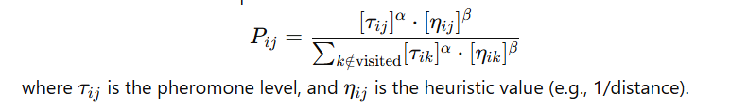
Ant Solution Construction
Each ant starts from a random node and incrementally builds a solution by choosing the next node based on a probabilistic rule:
An ant avoids revisiting already visited nodes.
Intuition: Pheromone levels guide ants to promising paths, while heuristic values emphasize problem-specific factors like shorter distances.

Slide 8
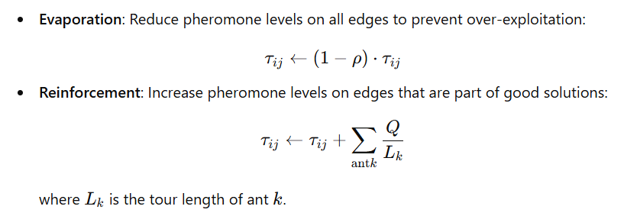
Pheromone Update
Q is Constant pheromone quantity.

Slide 9
Iteration
Repeat solution construction and pheromone update steps for a fixed number of iterations or until a stopping condition is met.
Stopping Conditions:
Maximum number of iterations.
Convergence: No significant improvement in solution quality over a specified number of iterations.
Intuition: Iterative exploration and refinement lead to gradual improvement in solution quality.

Slide 10
User-Controlled Parameters
Alpha (α): Controls the importance of pheromones. A higher α\alphaα makes ants rely more on pheromone levels.
Beta (β): Controls the importance of heuristic information. A higher β\betaβ emphasizes shorter paths.
Evaporation Rate (ρ): Affects the balance between exploration and exploitation. A higher ρ\rhoρ increases exploration.
Number of Ants: Impacts the diversity of solutions explored.
Maximum Iterations: Determines the computational effort.
Q: Influences the magnitude of pheromone updates.

Slide 11
Use and Demonstration: Ant Colony Optimization (ACO)
Suitable Problems for ACO
ACO is well-suited for combinatorial optimization problems, where the goal is to find an optimal arrangement or sequence under constraints. These problems often involve discrete variables and are computationally intensive to solve using exact methods. ACO excels because of its ability to explore a vast solution space efficiently while balancing exploration and exploitation.
Why ACO Works Well:
ACO is decentralized and robust, mimicking the adaptive behavior of ant colonies.
The algorithm efficiently handles dynamic changes and stochastic environments.
Positive feedback from pheromone trails guides the search toward high-quality solutions.

Slide 12
Examples of Suitable Problems:
Traveling Salesman Problem (TSP):
Finding the shortest route that visits all cities and returns to the starting city.
Vehicle Routing Problem (VRP):
Optimizing delivery routes for multiple vehicles.
Job Scheduling:
Allocating tasks to resources to minimize completion time.
Network Design:
Designing efficient and cost-effective communication or transportation networks.
Resource Allocation:
Distributing limited resources optimally among competing tasks.

Slide 13
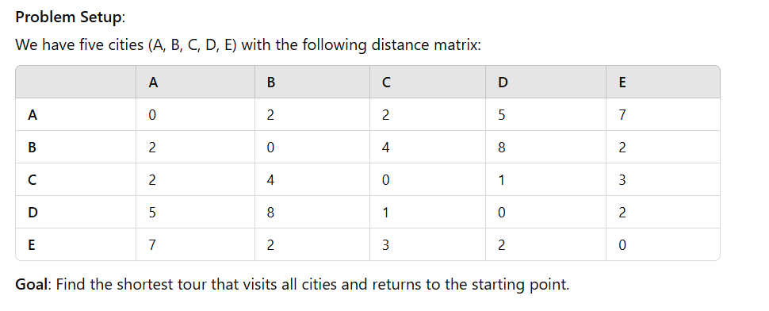
Demonstration on the Traveling Salesman Problem (TSP)

Slide 14
Step-by-Step Iteration
Initialization:
Pheromone levels are set uniformly on all edges (τij=1)
Parameters:
α=1 (pheromone importance).
β=5 (heuristic importance).
ρ=0.5 (evaporation rate).

Slide 15
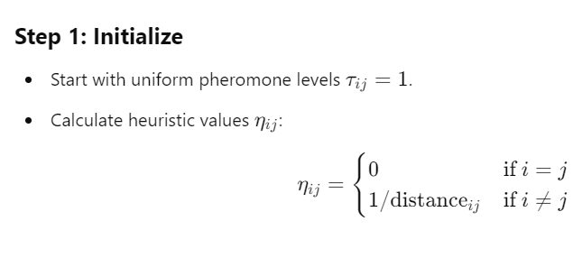
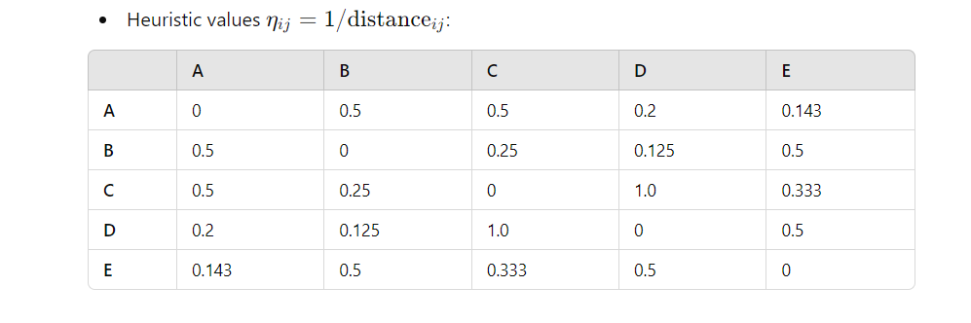
Initialization
Parameters:
α=1 (pheromone influence).
β=5 (heuristic influence).
Evaporation rate ρ=0.5.
Q=100 (Constant pheromone quantity)
Initial pheromone level τij=1 for all edges.
Heuristic value ηij=1/distanceij

Slide 16
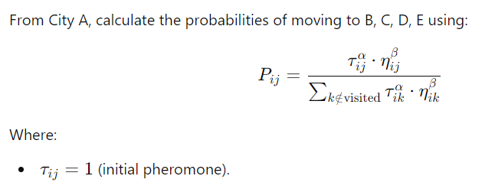
Iteration 1: ( Construct Solution)
Ants Construct Tours:
Each ant starts at a random city.
At city i the probability of moving to city j is calculated as

Slide 17
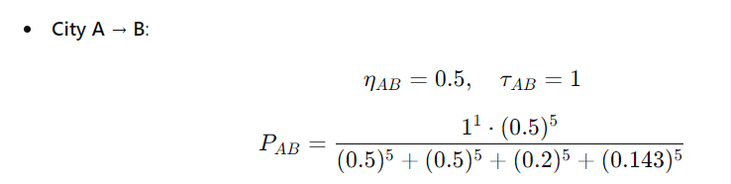
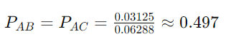
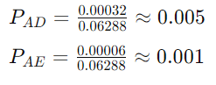
Iteration 1:
Similarly, we can calculate other, probabilities
Based on probabilities, the ant is most likely to move to City B or C.
Continue moving to unvisited cities until the tour is complete.
Normalization:
Total Probability=PAB+PAC+PAD+PAE
​Normalize each Pij​ by dividing by the total.

Slide 18
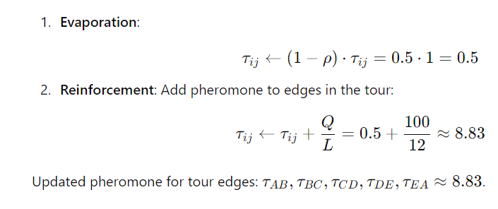
Update Pheromones: (Subsequent Iterations)
After completing a tour (e.g., [A → B → C → D → E → A]), calculate the total tour length:
Assume the total length is L=12
After the first iteration :
Tour: [A → B → C → D → E → A].
Total Length: L=12
Updated Pheromones: Reinforced on edges used in the tour, evaporated on others.
Stopping condition: Continue iterating until pheromone values stabilize and the shortest path is consistently identified.

Slide 19
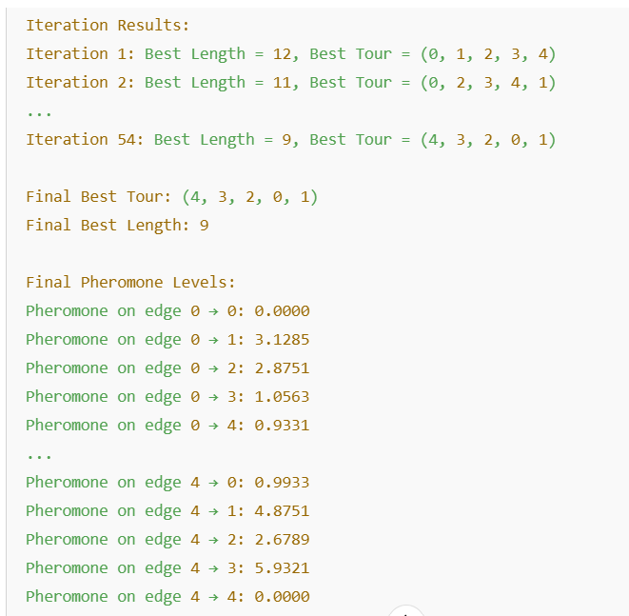
Result
After several (100) iterations (by using python script ), the ACO algorithm identifies the best tour:
Best Tour: [E → D → C → A → B→ E].
Over multiple iterations, the pheromone levels on the optimal route will become stronger, guiding the ants to consistently choose this path, causing the ACO algorithm to converge towards it.
Shortest Path Length: 9.
The shortest path that the ants travel is 9 starting from city E and travels back to same city.

Slide 20
Conclusion
This step-by-step process illustrates how ACO uses probabilistic decision-making and pheromone updates to iteratively improve solutions. For the TSP, ACO effectively balances exploration of new routes and exploitation of known good paths, converging to a near-optimal solution. This adaptability and efficiency make ACO a preferred approach for solving complex combinatorial problems.
Ant Colony Optimization (ACO) is a powerful and versatile algorithm inspired by the natural foraging behavior of ants. It has become a cornerstone in solving combinatorial optimization problems due to its ability to explore complex solution spaces efficiently while adapting dynamically to changes

Slide 21
Summary of the Method & Importance:
ACO models the collective behavior of ant colonies, using pheromone trails as a medium of communication. Through iterative processes of solution construction, pheromone updates, and evaporation, ACO balances exploration and exploitation to discover high-quality solutions. Its bio-inspired design allows it to handle a wide range of problems, including the Traveling Salesman Problem (TSP), Vehicle Routing Problem (VRP), and job scheduling.
Flexibility: It can be adapted to solve diverse optimization problems by modifying the heuristic information and pheromone update mechanisms.
Efficiency: The algorithm is capable of finding near-optimal solutions within a reasonable time frame, even for complex problems.
Real-World Applicability: ACO is widely used in logistics, transportation, network routing, and scheduling, where optimizing routes, resources, or tasks is critical.

Slide 22
Advantages and Disadvantages:
Advantages
Disadvantages
Robustness: Handles dynamic and stochastic environments effectively.
Parallelism: Multiple ants work simultaneously, exploring different solutions.
Scalability: Adaptable to various problem sizes and complexities.
Positive Feedback: Pheromone reinforcement encourages convergence toward optimal solutions.
Computational Cost: Can be computationally expensive for large-scale problems due to the number of ants and iterations.
Premature Convergence: Risk of converging to suboptimal solutions if pheromone levels become too concentrated on certain paths.
Problem-Specific Heuristics: Requires appropriate heuristic information to guide the search effectively.

Slide 23
Final Thoughts
ACO represents an elegant fusion of natural intelligence and computational techniques, making it a valuable tool in the field of optimization. Despite its limitations, ongoing advancements and hybrid approaches continue to enhance its efficiency and applicability. As industries increasingly rely on optimization to solve real-world challenges, ACO remains a vital and evolving algorithm for tackling complex problems.
Thank You

